Slide 1
ASSESSMENT OF LEARNING
UNIVERSITY OF ANTIQUE

Slide 2
Objectives
1.Discuss the role of assessment in the educative process.
2. Explain the teaching cycle
3. Define by giving examples, the term measurement, assessment & evaluation.

Slide 3
THE TEACHING CYCLE
Need & Interest Identifi-cation
Writing the Plan
Teaching
Assessment of Learning
Objectives & Subject matter Development

Slide 4
Can a teacher begin a class with a test?
Yes, definitely.
No, absolutely.
Yes, to determine the entry knowledge of the students.
Yes, to compare the performance of one class against another.

Slide 5
THE ROLE OF ASSESSMENT IN THE TEACHING-LEARNING PROCESS
THE OBJECT OF TEACHING IS LEARNING. WE CAN ALSO SAY THAT WE HAVE TAUGHT WHEN OUR STUDENTS HAVE LEARNED.
AN ACCURATE PICTURE OF WHETHER OR NOT OUR STUDENTS HAVE LEARNED THEREFORE IS IMPERATIVE

Slide 6
THE GOAL OF ASSESSMENT IS TO IMPROVE EDUCATIONAL OUTCOMES, TO IMPROVE THE TEACHING LEARNING PROCESS.

Slide 7
MEASUREMENT
THE PROCESS BY WHICH THE INFORMATION ABOUT THE ATTRIBUTES OR CHARACTERISTICS OF THINGS ARE DETERMINED AND DIFFERENTIATED

Slide 8
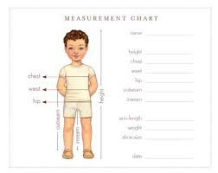

Slide 9


Slide 10
EVALUATION
THE PROCESS OF DETERMINING THE QUALITY OR WORTH OF ACHIEVEMENT IN TERMS OF CERTAIN STANDARDS, THE END VIEW IS THE IMPROVEMENT OF EDUCATIONAL OUTCOMES.
THE PROCESS OF GIVING MEANING OR INTERPRETATION TO THE RESULT OF MEASUREMENTS.

Slide 11
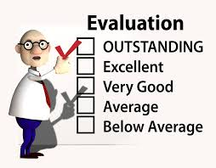

Slide 12
ASSESSMENT
THE COLLECTION OF DATA TO DESCRIBE AN ISSUE OR BETTER UNDERSTAND AN ISSUE. IT IS A PROCESS OF GATHERING DATA AND ORGANIZING DATA INTO INTERPRETABLE FORM TO HAVE A BETTER UNDERSTANDING OF ISSUES.

Slide 13
Question 1
Which of the following statements speak of assessment?
Your score is 15 out of 20.
You pass the test.
The result of your test shows that you understand the lesson.
You are a very bright student.

Slide 14
Question 2
Why do we assess learning?
To improve learning outcomes.
To evaluate success of learning.
To check if objectives are achieved
To make sure that it becomes an integral component of the educative process.

Slide 15
3.
NORMS are useful in
Measurement
Evaluation
Assessment
Testing

Slide 16
4. Which of these statements are correct?
I. Testing is a process where an instrument is used to measure attribute.
II. Measurement is a process of qualifying a given characteristics.
III. Evaluation is the analysis of qualitative and quantitative aspects.
IV. Assessment is the gathering of qualitative and quantitative data
A. I & II Only C. I, II & III
B. II & IV D. I, III & IV

Slide 17
5. Why are test norms established? To have a basis for ___________.
A.computing grades
B. interpreting test results
C. establishing learning goals
D. identifying pupil’s difficulties

Slide 18
II. Tell whether the following speaks of Measurement, Assessment or Evaluation
1. You did great in the examination.
2. The result of the LET showed that UA graduates perform better than other graduates taken as whole.
3. You have higher score than Peter.
4. You have satisfactory performed what is required of you.
5. I love you

Slide 19
II. Measurement, Assessment or Evaluation
6. You got a perfect score.
7. You are bright.
8. Your IQ test revealed that you are above average.
9. More effort is needed for you to improve your score.
10. You are beautiful

Slide 20
ASSESSMENT NUANCES
ASSESSMENT FOR LEARNING
ASSESSMENT OF LEARNING
ASSESSMENT AS LEARNING

Slide 21


Slide 22
Assessment FOR Learning
In assessment for learning, you begin by identifying the measurable evidence or criteria which would demonstrate students learning.
Objectives- Outcomes- Learning activities
Backward planning. (UbD- Understanding by Design)

Slide 23
Assessment for Learning
OBJECTIVES | To deliver a speech with no preparation at all.
ASSESSMENT/ EVIDENCE OF LEARNING | Impromptu Speech
LEARNING ACTIVITIES | Mechanics and Tips in Impromptu Speaking

Slide 24
LEARNING OBJECTIVES | SUCCESS CRITERIA
To recognize and name equivalent fractions | * Use objects or drawings to show equivalent fraction; Show examples of equivalent fractions Write a story about equivalent fraction

Slide 25
In assessment FOR learning, the focus is on:
Ways how to improve learning
New policies and procedures to improve learning
Formative assessment, diagnostic, aptitude evaluation

Slide 26
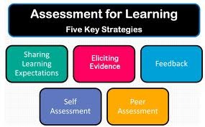

Slide 27
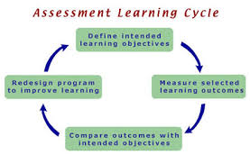
Assessment of Learning

Slide 28
In Assessment OF learning:
Focus is on test, on outcomes
Focus is on performance and grades, achievement
Here, you teach and then you administer test to find out if the students have learned.

Slide 29
Includes summative evaluation

Slide 30
Assessment AS Learning
This is used by students.
Here, the students use the result of his or her exam to improve his performance.

Slide 31
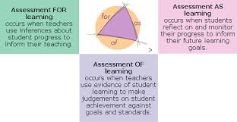

Slide 32
QUESTION
1. Which of the following a teacher strives to achieve when (s)he assess for students learning?
The level of performance
The accuracy of the grades.
The validity of the measuring instrument.
The appropriateness of the criteria that will serve as evidence of learning

Slide 33
QUESTION
2. How is “assessment for learning” different from “assessment of learning”?
A. It is for determining student grades.
B. It is for enhancing learning
C. It is for rating class performance
D. It is for determining class standing

Slide 34
3. Which of these should a teacher do when she assesses of students learning?
A. Designing her instruction.
B. Certifying students achievement.
C. Determine the areas of interest of students.
Giving immediate feedback to students regarding strength and weaknesses.

Slide 35
4. Jenny, a COTED student, uses the result of her long test in determining what to study or improve for the mid or final term examination. This is ____.
Assessment of Learning
Assessment as Learning
Assessment for Learning
A & C

Slide 36
5. The statement “test to teach” is consistent with ___________.
Assessment of Learning
Assessment for Learning
Assessment as Learning
Assessment with Learning

Slide 37
Which of the following is consistent with assessment of learning?
A. Diagnostic Test
B. Aptitude Test
C. Diagnostic Test
D. Summative Test

Slide 38
WHAT MAKES EDUCATIONAL MEASUREMENT & EVALUATION DIFFICULT?
MANY OBJECTS OF MEASUREMENT ARE ABSTRACT.
MANY OBJECTS OF MEASUREMENT THAT ARE MEASURED AS DISTINCT BY THEMSELVES MAY ACTUALLY REFER TO THE SAME THING.
MANY OF THE OBJECTS OF MEASUREMENT ARE BEHAVIOR AND BEHAVIOR ARE SUBJECT TO CHANGE.

Slide 39
WHAT MAKES EDUCATIONAL MEASUREMENT & EVALUATION DIFFICULT
4. THERE IS NO TRUE ZERO POINT TO START MEASUREMENT FROM.
5. THERE IS A SCARCITY OF MEASURING INSTRUMENTS TO GIVE ACCURATE MEASUREMENT.
6. ENVIRONMENTAL FACTORS.
7. HEALTH AFFECTS
8. CHEATING

Slide 40
SCORE OR ANY. VALUE DERIVED FROM MEASUREMENTIS IS RELATIVE. THEY HAVE TO BE INTERPRETED BASED ON THE INSTRUMENT USED IN EVALUATION

Slide 41
A student got a perfect score in a test. The most that we could say in this case is, _________.
he/se is a prodigy.
he/she is very diligent in the class
he/she has mastered the objectives.
he/she answered all the questions correctly.

Slide 42
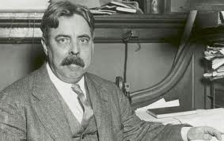
HISTORY OF M & E:
CHINESE and public examination
Rev. James Fisher
Edward Lee Thorndike

Slide 43
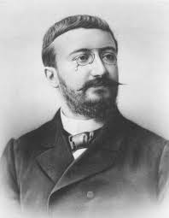
Binet-Simon Intelligence Scale Test

Slide 44

Army Alpha & Army Beta

Slide 45
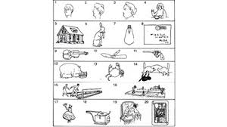
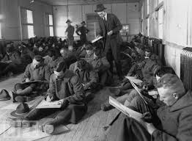

Slide 46
PRINCIPLES OF ASSESSMENT
1. SIGNIFICANCE

Slide 47
PRINCIPLES OF EVALUATION
2. CONTINUITY
WHEN TO CONDUCT | TYPE | EXAMPLE
1.PRIOR TO INSTRUCTION | 1.Diagnostic 2.Aptitude | Readiness Test
2.DURING INSTRUCTION | FORMATIVE | Quiz Recitation
3.AFTER INSTRUCTION | SUMMATIVE TEST | Unit Test Periodic Exam

Slide 48
Question
1.Which of the following should a teacher focus if (s)he wants to assess of students learning?
Diagnostic Evaluation
Aptitude Evaluation
Formative evaluation
Summative Evaluation

Slide 49
Question
2.The teacher without waiting the class to be over ask the students of their understanding of the concept.
A.formative C. summative
B. Diagnostic D. Aptitude

Slide 50
3. Assessment of Learning is said to have started in _______.
Japan C. China
Egypt D. USA

Slide 51
4. A quiz is ___________ evaluation.
Summative C. Formative
Diagnostic C. Aptitude

Slide 52
5. Readiness test is an example of ________.
Diagnostic evaluation
Summative evaluation
Aptitude evaluation
Formative

Slide 53
6. A test which is useful in predicting potential failure or success is __________.
Summative
Formative
Aptitude
Prognostic

Slide 54
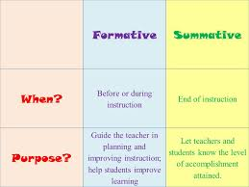

Slide 55
PRINCIPLES OF EVALUATION
3.SCOPE/
COVERAGE

Slide 56
Is this valid?
TOPIC | ITEMS
A | 10
B | 10
C | 10
D | 10
E | 10

Slide 57
Is this valid?
TOPIC | ITEMS
A | 5
B | 7
C | 10
D | 15
E | 3

Slide 58
TABLE OF SPECIFICATION
TOPICS | OBJECTIVES | Time Allotment | RW | Number Of Items | Test Type | Item Locator
A B | a | 3 hrs 2 | 0.11 0.07 | 8 5 | MCQ T/F MCQ | 1, 3,8,9, 11 2,5,7 2,4,6,7,10
II. A |  | 4 | 0.15 | 12*
III. A B |  | 2 2 | 0.07 0.07 | 5 5
IV. A |  | 6 | 0.22 | 17*
V. A B |  | 2 3 | 0.07 0.11 | 5 9*
VI.A |  | 3 | 0.11 | 9*
Total |  | 27 | 0.98 | 75

Slide 59
PRINCIPLES OF EVALUATION
4.COMPATIBILITY

Slide 60
PRINCIPLES OF EVALUATION
5 VALIDITY
Which of the following test items is valid to measure the objective: to solve problems involving percent?
A. What is percent?
B. John got 75% in a test. Is this a good score?
C. What is ¾ to percent?
D. Mark got 8 baskets in 10 attempts. What percent did he miss?

Slide 61
PRINCIPLES OF EVALUATION
6.OBJECTIVITY
(FAIRNESS)

Slide 62
PRINCIPLES OF EVALUATION
7 RELIABILITY
=Consisteny/ Stability

Slide 63
PRINCIPLES OF EVALUATION
8 DIAGNOSTIC VALUE

Slide 64
Which test has the diagnostic value as its greatest strength?
A. Multiple Choice
B. Essay
C. True/False
D. Matching Type

Slide 65
PRINCIPLES OF EVALUATION
9 PARTICIPATION

Slide 66
PRINCIPLES OF EVALUATION
10. VARIETY

Slide 67
PURPOSES OF TEST
Instructional
Grading
Selection
Counselling & Guidance
Curriculum
Administrative Policy
Certification

Slide 68
Question
An assessment test is given to BSHRM students designed to measure whether or not they have the competency to do the job. What purpose is this test trying to satisfy?
A. Instructional
B. Curriculum
C. Certification
D. Selection

Slide 69
2. A teacher made test items from a topic he likes teaching but excluded other topics in the test. Which principle of assessment was violated?
Compatibility C. Scope
Realibility D. Objectivity

Slide 70
3. A test is fair when ________.
It is not essay type.
It is objective type.
The teacher is not to think when scoring.
The teacher’s opinion or idea does not affect how the paper is scored.

Slide 71
4. A test which produces more or less the same scores when conducted twice is said to be ________.
Valid C. reliable
Objective D. appropriate

Slide 72
5. A teacher has to make a test. What should the teacher has to do first?
A. Determine number of items.
B. Determine the test type.
C. Review the objectives
D. Make a TOS

Slide 73
6. Where is the proper time to give the test?
Before the start of the class
During the class discussion
After the class discussion
Anywhere

Slide 74
MEASURING INSTRUMENTS
CONVENTIONAL ASSESSMENT TOOLS: REFERS TO THE PAPER & PENCIL TEST AND OTHER COMMON MODE OF ASSESSMENT | AUTHENTIC ASSESSMENT TOOLS THIS REQUIRE THE STUDENTS TO DO A SPECIFIC TASK

Slide 75
TYPES OF TEST: According to Function
EDUCATIONAL TESTS | PSYCHOLOGICAL TESTS
Measures Educational Outcomes | Measures intangible aspects of learners’ behavior Example:
 | 1. Intelligence Test- Measures general mental ability
 | 2.Aptitude Test – predicts future performance
 | 3. Personality Test - measures intangible aspects of personality:
 | a. Rating Scale
 | b. Personality Inventory
 | c. Projective Techniques

Slide 76
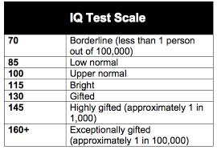

Slide 77
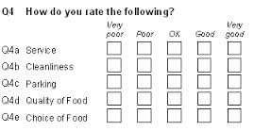
Rating Scale

Slide 78
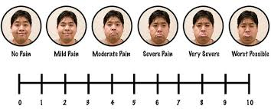

Slide 79
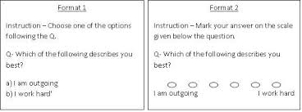

Slide 80

Rorschach Inkblots

Slide 81


Slide 82
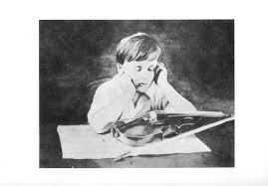
Thematic Apperception Test

Slide 83
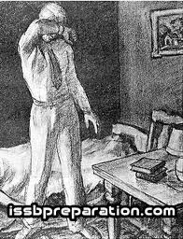

Slide 84
TYPES OF TEST: According to Language Mode
VERBAL TESTS | NON-VERBAL TESTS
Consists of words and entails reading, writing or speaking | Composed of numerals or drawing

Slide 85
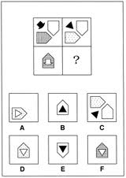

Slide 86
TYPES OF TEST: According to Nature and Manner of Administration
TEACHER-MADE TESTS | STANDARDIZED TESTS
1. Construct by teachers | 1. Constructed by experts over a period of years
2. Measure specific objectives | 2. Measure broad objectives
3. Measure performance | 3.Measure performance & innate potentials
4. No normative data; not copyrighted; administered to class | 4. Often has normative data; usually copyrighted; administered to hundreds or thousands of examinees
5. Procedure in test-taking is often dictated by teachers | 5. Administered using uniform procedure

Slide 87


Slide 88
TYPES OF TEST: According to Interpretation of Scores
CRITERION-REFERENCED TEST | NORM-REFERENCED TEST
Scores are interpreted in regard to a certain criterion, often stated in the objective | Describe the performance of the examinees in terms of the relative position in the group
1. You can make 6 knots in 2 minutes | 1. You topped the test
2. You have named 11 of 15 parts of a microscope | 2. You are the lowest
3. Your score is 15 | 3. Your z-score is +2.
 | 4. Your score is equal to 80%ile

Slide 89
Consider this objective:
After a demonstration using the microscope, the students must be able to name at least 12 of 16 parts of the microscope.

Slide 90
WITH THE USE OF PERIODIC TABLE, THE STUDENTS MUST BE ABLE TO IDENTIFY WHETHER THE ELEMENTS ARE METALS, NON-METALS OR METALLOIDS WITH COMPLETE ACCURACY.

Slide 91
AFTER THE DISCUSSION ON THE CHARACTERISTICS OF A RUBRIC, THE STUDENTS MUST BE ABLE TO RATE A RUBRIC THAT THEY HAVE MADE.

Slide 92
PERCENTILE
Is a score below which a number of cases lie.

Slide 93
RUBY’S PERCENTILE RANK IN A TEST IS 80. What does it mean?

Slide 94
Question
In a test, the score of Peter is 72 which is equivalent to 85percentile. What percent of the class have scores lower than 72?
A. 72 B. 85
B. 27 D. 86

Slide 95
TYPES OF TEST: According to Time Requirement
Power test | Speed test
Time is often not really followed | Have strict time limit
Measures accuracy | Measures speed

Slide 96
SPEED TEST | POWER TEST
Set A (20 items) = 10 minutes | The test is 100 items and good for 60- minutes or 1 hour.
Set B (50 items)= 30 minutes | You are free to adjust your time such that you could answer the test in the prescribed time.
Set C (10 items) = 5 minutes
Set D (20 items)= 15 minutes

Slide 97
TYPES OF TEST: According to Item Format
SUPPLY TYPE | SELECTIVE TYPE
Require the examinees to provide answer from the given options | Ask the examinees to provide answer from the given options
Ex: Simple Recall, Labelling, Completion test | EX; MCQ, MATCHING TEST, TRUE/FALSE

Slide 98
TYPES OF TEST: According to DOMAIN OR TARGET MEASURED
COGNITIVE TEST | AFFECTIVE TEST | PSYCHOMO- TOR TEST

Slide 99
1. What is presented in the thematic apperception test?
A. inkblots C. abstract image
B. pictures D. objects

Slide 100
2. When the test goes to completion without any student asking how to answer it, then the test _____.
Is valid
Is realiable
Is objective
Is good in administrability

Slide 101
3. A test is designed in such a way that passing or failing depends on the relative performance of the students compared to the group. This test is _________.
A. norm-referenced
B. criterion-referenced
C. standardized
D. teacher-made

Slide 102
4. Which of the following information is necessary when reporting to parents the result of a norm-reference test?
The passing score.
The score that signifies mastery.
The group who took the test.
The value that indicates adequate performance

Slide 103
5. What is in the teacher-test which a standardized test cannot replace?
A. Its being valid and reliable.
B. Its beind easy to score.
C. Its ability to measure specific classroom objectives.
D. Its ability to measure both innate abilities and performance.

Slide 104
6. A teacher gave an enumeration test to measure whether the students have attained the objective, to name all the parts of the cell.
If Paul missed one part of the cell, thus committing one mistake, is his score passing?
A. NO C. YES
B. Maybe D. It depens

Slide 105
7. Which of the following is a norm-referenced interpretation?
A.”Passing in this test is 10”
B. “You have to make 5 knots in 2 minutes”.
C. “You must be able to encode 300 words in 7 minutes without mistake”.
D. “Only the top 40 scorers will be admitted in the scholarship”

Slide 106
8. Which of the following does not belong to the group?
A. MCQ
B.True/False
C. Simple Recall
D. Completion Test

